Slide 1
Naïve Bayes
Only for classification problems
Specifically on text data as in sentiment analysis.

Slide 2
Before starting remember two things
Conditional Probability :
P(A/B) = P(A and B)/P(B)
Independence: Means two event are statically independent:
P(A and B) = P(A).P(B)

Slide 3
Proof of Bayes’ Theorem

Slide 4
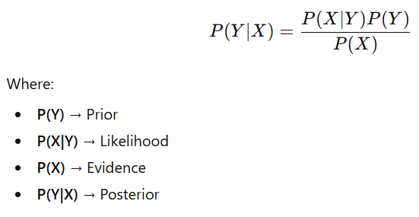
Bayes Theorem

Slide 5
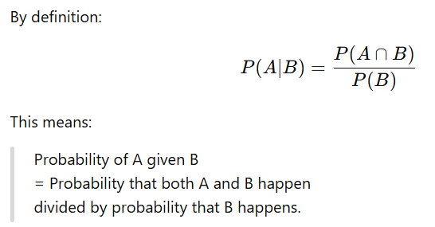
Step 1: Conditional Probability

Slide 6
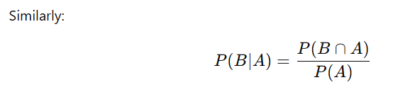

Slide 7
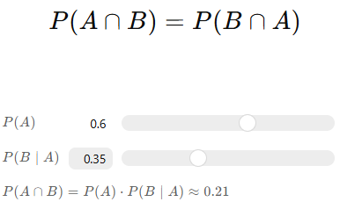
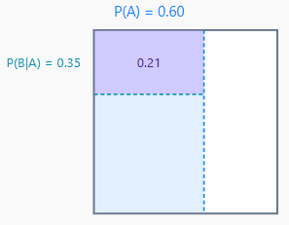
Step 2: Important Observation

Slide 8
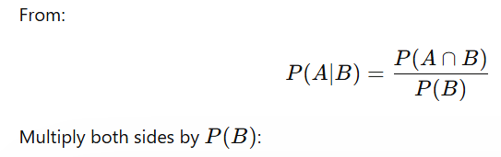
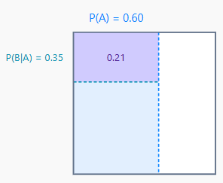
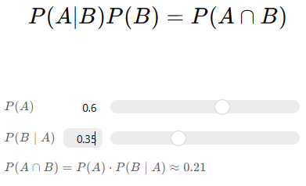
Step 3: Rearranging the First Equation

Slide 9
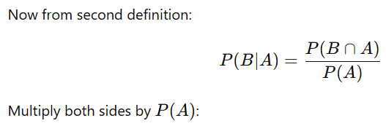
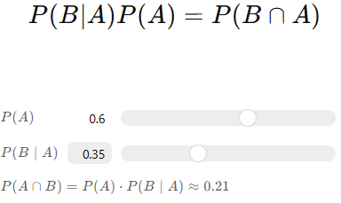
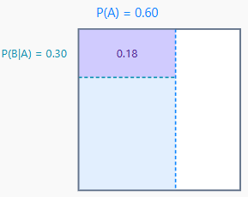

Slide 10
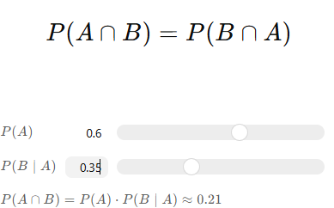
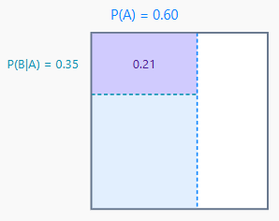
Step 4: Since Both Right Sides Are Equal

Slide 11
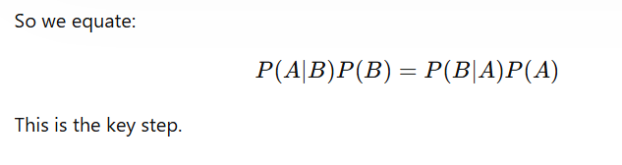

Slide 12
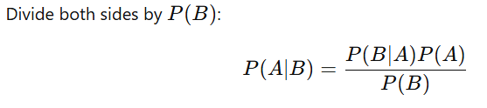
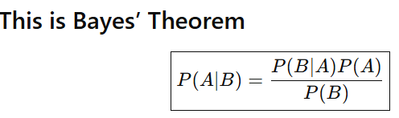
Step 5: Solve for P(A∣B)

Slide 13
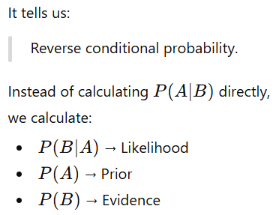
Intuition Behind It

Slide 14
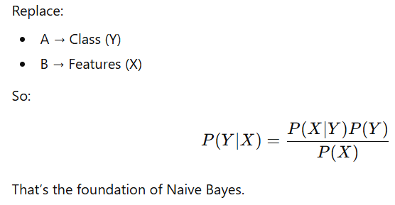
In Naive Bayes Context

Slide 15
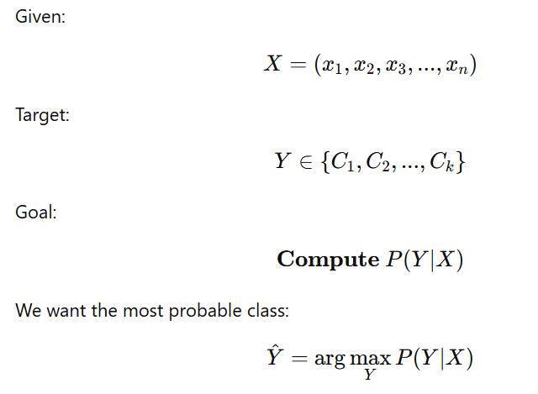
Problem Setup

Slide 16
What is X=(x1,x2,...,xn)?
This X is feature vector.
Example 1: Weather dataset
x1​ = Outlook
x2​ = Temperature
x3​ = Humidity
x4​ = Wind
So one data point becomes:
X=( Sunny, Cool, High, Strong)
Example 2: Student dataset
x1​ = Hours studied
x2​ = Attendance
x3​ = Internal marks
X=(5,80%,18)

Slide 17
What is Y ∈ {C1,C2,...,Ck} ?
This is the target variable (class label).
It can take one of k possible classes.
Examples:
Spam / Not Spam
Yes / No
Pass / Fail
Positive / Negative
Class A / Class B / Class C
So:
Y∈ {C1,C2,...,Ck}

Slide 18
What Are We Trying To Compute? P(Y∣X)
This means:
What is the probability that the class is Y, given the features X?
Very important interpretation:
We are not asking:
What is probability of features given class? We are asking:
What is probability of class given features?

Slide 19
Example:
If:
X=(Sunny,Cool,High,Strong)
We want:
P(Yes∣Sunny,Cool,High,Strong) P(No∣Sunny,Cool,High,Strong

Slide 20

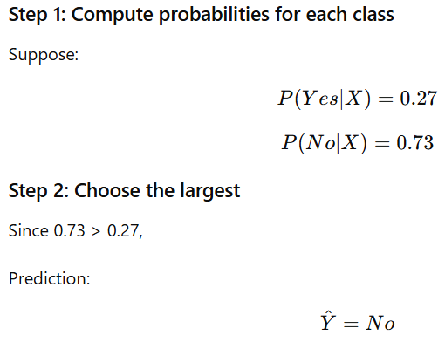
Why Do We Take argmax?
It means: Choose the class Y for which probability is maximum.
We want the most probable class given the evidence.
This is called: Maximum A Posteriori (MAP) Decision Rule

Slide 21

In naïve bayes:
We are assuming Features are independent

Slide 22
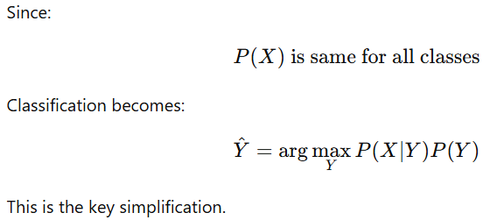
We Ignore Evidence
Argmax means: choose the class that gives the highest probability.

Slide 23
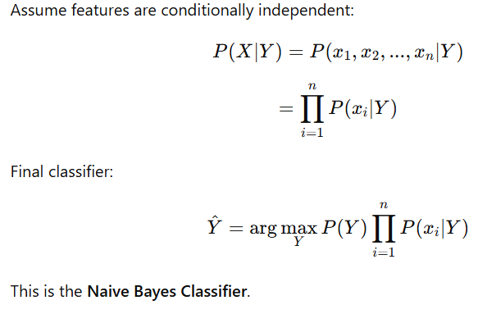
Naive Independence Assumption

Slide 24
Play Tennis Dataset
Problem Statement
Given weather conditions:
Outlook
Temperature
Humidity
Windy
Predict:
Y= Play Tennis (Yes/No)
Solve:
Case 1 :P(Yes∣Sunny,Cool,High,Strong)
Case 2: P(No∣Sunny,Cool,High,Strong)

Slide 25
Dataset
Sr No. | Outlook | Temp | Humidity | Windy | Play
1 | Sunny | Hot | High | False | No
2 | Sunny | Hot | High | True | No
3 | Overcast | Hot | High | False | Yes
4 | Rainy | Mild | High | False | Yes
5 | Rainy | Cool | Normal | False | Yes
6 | Rainy | Cool | Normal | True | No
7 | Overcast | Cool | Normal | True | Yes
8 | Sunny | Mild | High | False | No
9 | Sunny | Cool | Normal | False | Yes
10 | Rainy | Mild | Normal | False | Yes
11 | Sunny | Mild | Normal | True | Yes
12 | Overcast | Mild | High | True | Yes
13 | Overcast | Hot | Normal | False | Yes
14 | Rainy | Mild | High | True | No

Slide 26
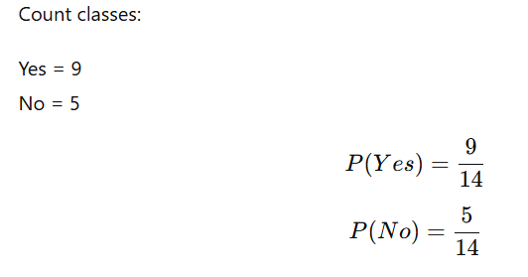
Step 1 : Compute Priors

Slide 27
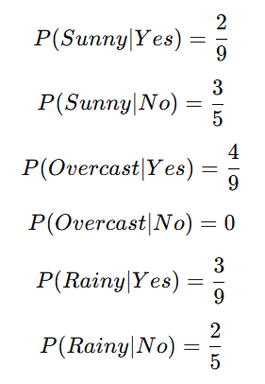
Step 2: Convert Dataset Into Conditional Tables
Outlook
Outlook | Yes | No
Sunny | 2 | 3
Overcast | 4 | 0
Rainy | 3 | 2

Slide 28
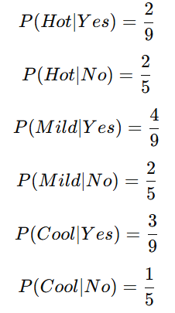
Temperature:
Temperature | Yes | No
Hot | 2 | 2
Mild | 4 | 2
Cool | 3 | 1

Slide 29
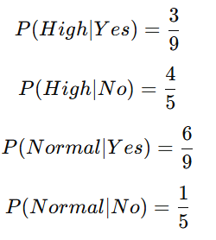
Humidity
Humidity | Yes | No
High | 3 | 4
Normal | 6 | 1

Slide 30
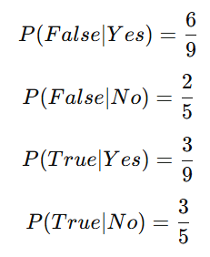
Windy
Windy | Yes | No
False | 6 | 2
True | 3 | 3
(Strong = True, Weak = False)

Slide 31
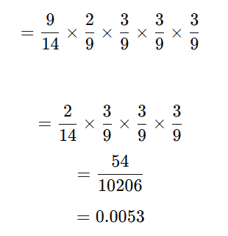
Step 3: Apply Naive Bayes Formula
P(Yes∣X) ∝ P(Yes)P(Sunny∣Yes)P(Cool∣Yes)P(High∣Yes)P(Strong∣Yes)
Where: X = outlook as sunny, temp as cool, humidity as high, windy as strong

Slide 32
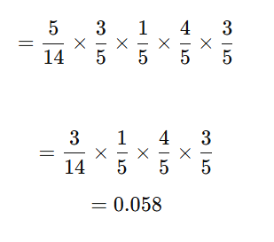
P(No∣X) ∝ P(No)P(Sunny∣No)P(Cool∣No)P(High∣No)P(Strong∣No)

Slide 33
Step 5: Compare
0.0053<0.058
No, you will not play tennis.

Slide 34
Introduce Laplace Smoothing
Given:
Outlook = Sunny Temperature = Cool Humidity = Normal Clothes = Formal
Case 1: P(Yes∣Sunny,Cool,Normal,Formal)
Case 2 : P(No∣Sunny,Cool,Normal,Formal)

Slide 35
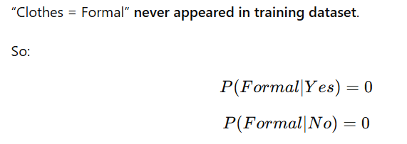
Step 1: Identify the Problem
Without smoothing:
Entire product becomes 0 for both classes.
Model cannot decide.

Slide 36
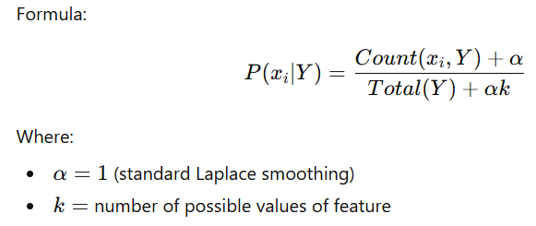
Step 2: Apply Laplace Smoothing

Slide 37
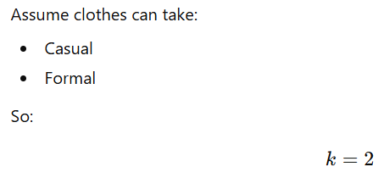
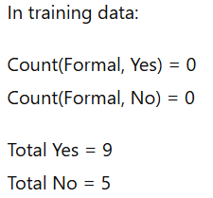
For Clothes Feature

Slide 38
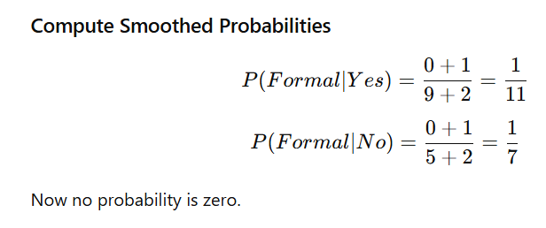

Slide 39
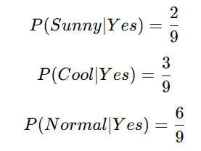
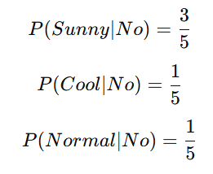
Step 3: Other Probabilities

Slide 40
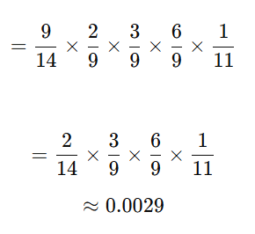
Step 4: Compute Posterior for Yes
P(Yes∣X) ∝ P(Yes)P(Sunny∣Yes)P(Cool∣Yes)P(Normal∣Yes)P(Formal∣Yes)

Slide 41
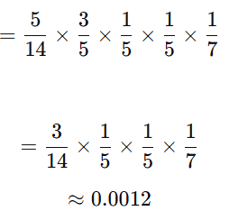
Step 5: Compute Posterior for No
P(No∣X) ∝ P(No)P(Sunny∣No)P(Cool∣No)P(Normal∣No)P(Formal∣No)

Slide 42

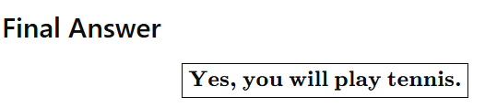
Step 6: Compare

Slide 43
Overfitting and Underfitting
Naive Bayes is generally:
High Bias, Low Variance Model.
Because of the strong conditional independence assumption.
So compared to models like Decision Trees, Naive Bayes usually:
Rarely severely overfits
More likely to underfit
But smoothing parameter can change this behavior.

Slide 44
What is Overfitting? and How Can NB Over fit ?
Model performs:
Very well on training data
Poorly on test data
So High variance problem.
Even though NB is simple, overfitting can happen when:
1. Very small dataset: If counts are tiny, probabilities become extreme.
Example: If a word appears once in spam:
P(word∣spam)=1
Model becomes too confident.

Slide 45
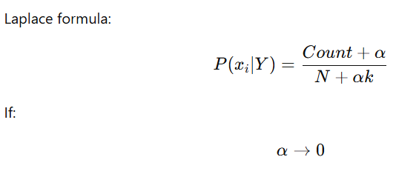
2. Very small smoothing (α ≈ 0)
Then:
Probabilities depend purely on raw counts.
Rare events get extreme probabilities.
Model memorizes training data.
That is overfitting.
Low α → very sharp probabilities
Model trusts training data too much
High variance

Slide 46
What is Underfitting in Naive Bayes
Model performs:
Poorly on training and Poorly on test
High bias problem.
Because of independence assumption:
P(x1,x2∣Y)=P(x1∣Y)P(x2∣Y)
But in real life:
Features are often correlated.
Example:
Humidity and Temperature may be related.
NB ignores this relationship.
So decision boundary becomes too simple.
That is underfitting.

Slide 47
Very large smoothing (α very high)
If: α≫1 Then:
P(xi∣Y) ≈uniform distribution
Model ignores actual data patterns.
All probabilities become similar.
Predictions become weak.
That is underfitting.

Slide 48
Naïve Bayes for Sentiment Analysis Text → OHE → Sparse Matrix → Bag of Words → Naive Bayes for Sentiment.
For text-based sentiment analysis, Multinomial Naive Bayes is often a strong baseline model due to its efficiency and strong performance on high-dimensional sparse data.
Despite its strong independence assumption, Naive Bayes works remarkably well in text classification because text data is high-dimensional and sparse.
Let us go with example

Slide 49
For text Data
Text = My name is Pankaj Sharma
Vector form = [10000] [01000] [00100] [00010] [00001]
This is named as one hot encoding.
Each word in vocabulary is represented as:
A vector of length = vocabulary size
Only one position = 1
All others = 0
So OHE represents a single word.

Slide 50
Limitation of OHE
Cannot represent full sentence directly
I like this product , OHE gives 4 separate vectors.
It does not combine them into one document representation.
No frequency information
good good good product
OHE treats each word independently.
It does not capture repetition.
Very High Dimensional
If vocabulary = 50,000 words
Each word vector = length 50,000
Huge sparse vectors.

Slide 51
No semantic meaning
Distance between: good and excellent
Same as: good and table
No meaning captured.
This lead to new approach named as bag of word (BOW)

Slide 52
Bag of Words (BoW)
Instead of encoding single word, We encode entire document as a vector.
Vocabulary:
[I, like, this, product, do, not, think, good, amazing, regret, buy, me]
Document example:
I like this product
Vector becomes:[1 1 1 1 0 0 0 0 0 0 0 0]
Do not buy this product : [0 0 1 1 1 1 0 0 0 0 1 0]

Slide 53
Sparse Matrix
Most values are 0.
That’s why it is called:
Sparse Matrix
Efficient storage used in NLP.

Slide 54
Why Bag of Words is Better than OHE?
OHE | Bag of Words
Single word | Whole document
No frequency | Captures frequency
Cannot train NB | Perfect for NB
Very limited | Practical for ML

Slide 55
Using Bag of Words for Sentiment Analysis
Positive reviews:
I like this product
Amazing product
Negative reviews:
Do not buy
I regret this
After BoW conversion:
Each document → numeric vector
Now we can compute:
P(word∣Positive)
P(word∣Negative)
Exactly like Play Tennis example.

Slide 56
How Naive Bayes Uses BoW
For a new review:
I like this amazing product
We compute:
P(Positive∣X) ∝ P(Positive)∏P(wordi∣Positive)
Words like :
Like,amazing,product
Have higher probability in positive class.
So posterior becomes larger.

Slide 57
Why Naive Bayes Works Well in NLP
Even though independence assumption is false:
High dimensional data
Sparse matrix
That’s why Multinomial Naive Bayes is very powerful for text.

Slide 58
TF-IDF as an Improvement
After BoW,
Question can be:
“But what if common words dominate?Can we reduce their importance?”
The answer is TFIDF

Slide 59
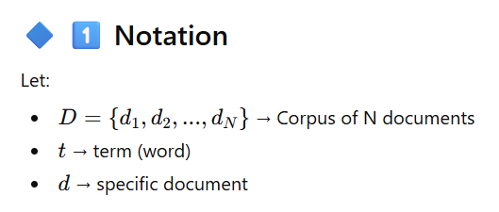
TF–IDF (Term Frequency – Inverse Document Frequency)
TF–IDF is a numerical representation of text that reflects:
How important a word is in a document
Relative to the entire corpus

Slide 60
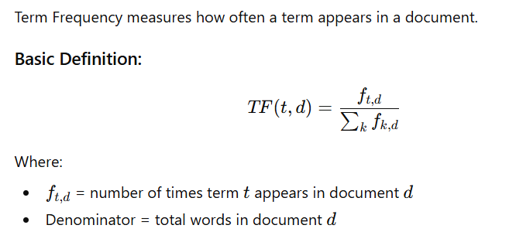

Term Frequency (TF)

Slide 61
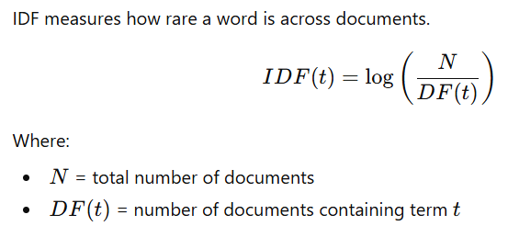
Document Frequency (DF)
DF(t)=Number of documents containing term t
Inverse Document Frequency (IDF)

Slide 62
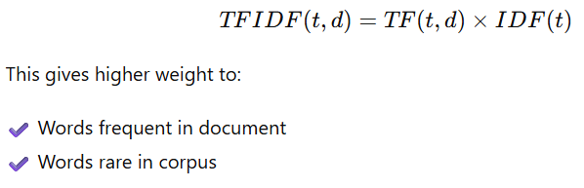
TF–IDF Formula

Slide 63
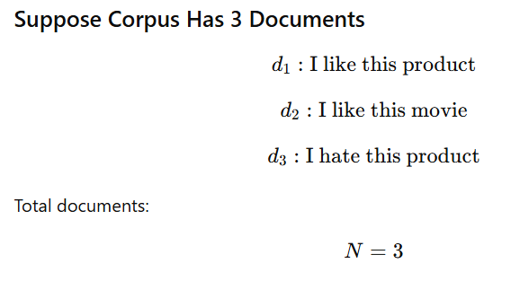
Numerical Example

Slide 64
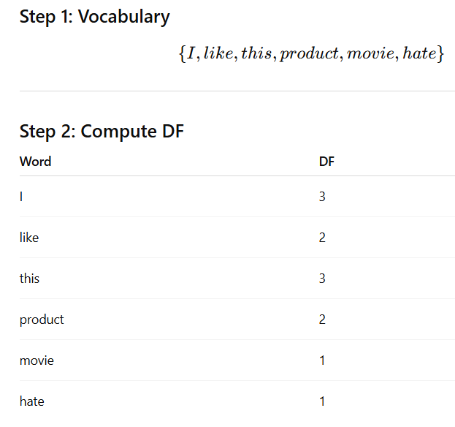

Slide 65
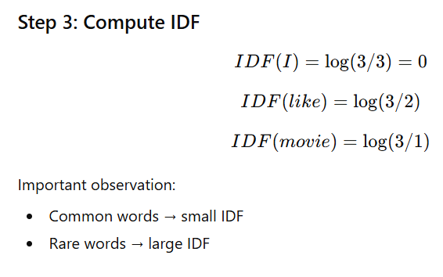

Slide 66
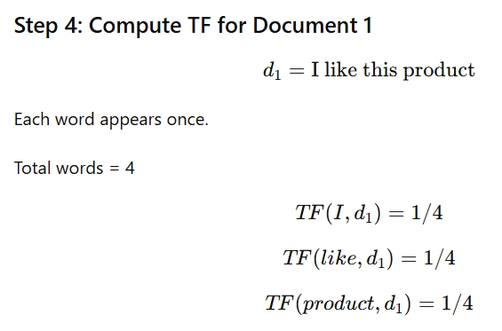

Slide 67
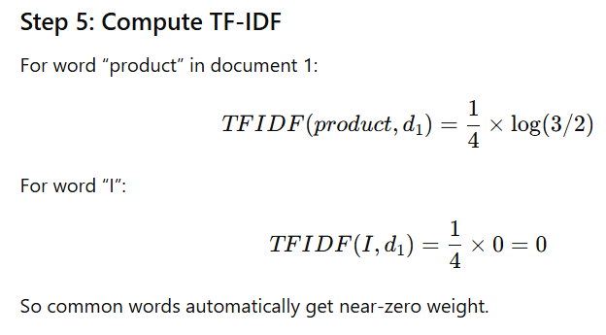

Slide 68
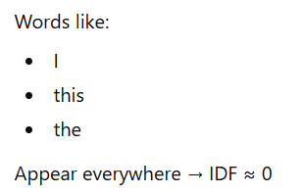

Why This Helps in Sentiment Analysis
So they influence classification more.

Slide 69

Final Matrix Representation

Slide 70
Practical Recommendation
For sentiment analysis:
Try both:
CountVectorizer + MultinomialNB
TfidfVectorizer + MultinomialNB
Compare accuracy.
Very often TF-IDF performs slightly better.

Slide 71
When TF-IDF Is Helpful
If dataset has many common words:
product
good
buy
movie
the
this
TF-IDF reduces their dominance.
Gives importance to rare but meaningful words like:
excellent
horrible
regret
outstanding

Slide 72
Final Takeaways – Naive Bayes
Naive Bayes is a probabilistic generative classifier
Based on Bayes Theorem and independence assumption
Works extremely well for high-dimensional sparse data
Requires small training data
Computationally efficient

Slide 73
In Text Classification
✔ Multinomial NB is powerful ✔ Works well with BoW and TF-IDF ✔ Surprisingly effective despite wrong assumptions
In Tabular Data
✔ Simple ✔ Fast ✔ Baseline model
Limitations
❌ Independence assumption unrealistic ❌ Cannot capture feature interactions ❌ Probability estimates not always well calibrated
When To Use It?
✔ Spam detection ✔ Sentiment analysis ✔ Document classification ✔ As a baseline model

Slide 74
Final Thought:
Naive Bayes is simple, but simplicity does not mean weakness. In high-dimensional problems, it is often surprisingly powerful.

